Slide 1
SAP Process Integration
Integration Directory

Slide 2

Integration Directory PI 7.1
Agenda
PI 7.1 Integration Directory
Overview and Concepts
Business Scenarios
Collaboration Profiles
Routing Rules
Collaboration Agreements

Slide 3
PI Configuration Concept
The goal of the Integration Directory is for the customer to configure the sender-receiver relationships which will be used at runtime.
Service A
Service B
Notes:
When creating sender-receiver relationships, there are many aspects to consider. For instance:
Which Business System should receive the message?
Which interface should receive the message?
What transport mechanism will be used?
What security requirements exist?
The XI Integration Repository is used to set these and other parameters so that messages can be processed properly as they arrive at the Integration Server.
When the IS receives a message, it examines the message header to determine the sender Service (for instance, a Business System) and the sender interface and namespace; using this information as a key, it finds the correct receiver information from the configuration and forwards the message with necessary processing.

Slide 4
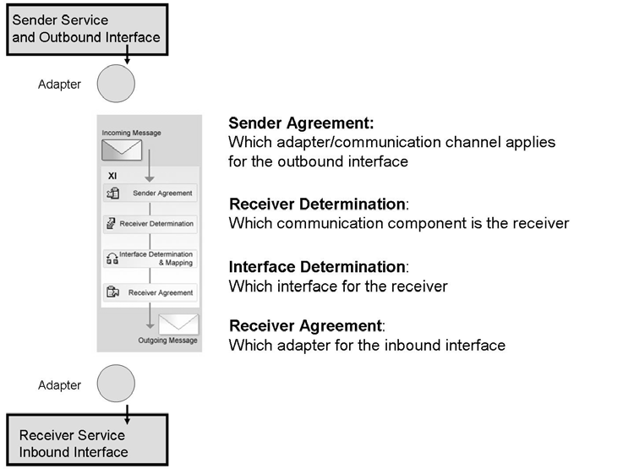
Configuration Objects in the Integration Directory

Slide 5
PI 7.1 Integration Directory: Overview
Integration Builder
Integration Directory
Adapt integration content to specific configuration
Delivered empty, without predefined content
all content is customer-specific
Integration content derived from Integration Repository
Open for Customer to add collaboration knowledge relevant to non-SAP components
Home for centralized adapter configuration
Data provider for IS runtime
Integration Directory
Confiuration Scenarios
Configuration
Wizards
Business Processes
Collaboration Profiles
Parties , Services
& Channels
Configuration
Editors
Routing Rules
Receiver Determination Rules
Interface Determination Rules (including Mapping Assignment)
Collaboration Agreements
Sender & Receiver Agreements,
Receiver rules, ICO
Notes:
The Integration Directory is used to configure the Business Scenarios that are created at design time in the Integration Repository. The prerequisites for configuring a scenario in the Integration Directory are that the internal system landscape is implemented in the System Landscape Directory, and that the design objects relevant for the process are defined in the Integration Repository.
Integration Scenarios are developed in the IR, configured in the ID, and executed at runtime by the Integration Server. The Integration Server uses a cached copy of the configuration from the ID to process messages delivered to the pipeline.
The Integration Directory is initially delivered without content. The customer must add content that corresponds to the concrete landscape of the customer solution.
The Integration Directory content can be partially derived from the content of the Integration Repository. For instance, Business Scenarios in the IR are the basis for the configuration wizard in the ID.
Starting with PI 7.1, J2EE-based adapters can be configured centrally in the ID.
The Integration Builder supplies configuration wizards that makes it easy to create all of the configuration objects for a given scenario. Alternately, you can create the relevant objects manually using editors.

Slide 6
Task Areas At Configuration Time
Area in the Integration Directory | Tasks
Collaboration Profile (Objects: Communication Party, Communication Components, Communication Channel) | In the collaboration profile, you document the technical options available to the communication parties for exchanging messages. Specify the potential senders and receivers of messages and the technical communication paths.
Logical Routing (Objects: Receiver Determination, Interface Determination) | In logical routing, you define the flow of messages in a system landscape.
Collaboration Agreement (Objects: Sender Agreement, Receiver Agreement,ICO) | In collaboration agreements, you define the technical details for message processing (for example, adapter configuration) and the security settings for specific sender/receiver pairs.
Notes:
The three task areas at Configuration time are the Collaboration Profile, Logical Routing, and the Collaboration Agreement.
In the Collaboration Profile you specify which services (Business Service, Business Process, or Business System) will participate in a message exchange. For each you may also specify a Communication Channel, which represents the technical communication path (For instance, the adapter type and configuration parameters for the adapter).
In Logical Routing you determine both who should be the receiver of a message and what interface should receive the message.
In a collaboration agreement you define which communication channel to use to process messages for particular combination of senders and receivers. Collaboration Profiles represent, in effect, possible configurations, while Collaboration Agreements represent actual configurations.

Slide 7
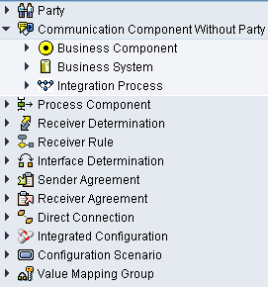
Collaboration Profile Objects
Communication components are used to:
Represent a technical or business unit, which is to be addressed as the sender or receiver of messages.
Group interfaces to exchange messages according to particular task areas.
Address business systems and business processes as senders or receivers of messages.
A communication party represents a larger unit which is involved in a cross-system process (for example a company).
A Communication Channel defines how an adapter transforms a message so that it can be processed by the Integration Engine
Notes:
A communication Party represents a larger unit, which is involved in a cross-system process, for example a company. You can assign each communication party one or more services and address these services as the sender or receiver of messages.
Communication Parties can be assigned alternative identifiers; across the world, many different identifiers are used to identify companies involved in cross-company processes (for example, Dun & Bradstreet D-U-N-S-Number). In the Integration Directory, you can specify multiple alternative identifiers for a communication party, which you can then use to identify this party (for example, when specifying receiver determinations).
Services can be Business Services, Business Processes, or Business Systems:
A Business Service represents an abstract, addressable unit. Business services are used in cross-company processes, for example, if the parties involved have only published their interfaces and not their system landscape, or it is only partly known. Using a business service, you can define the technical or business subunits of the companies involved and then assign them the relevant interfaces.
A Business System addresses a business system as a sender or receiver of messages. Unlike an abstract service, a business system represents a specific (application) system in the system landscape. A business system (service) comprises information about the inbound and outbound interfaces and the software component versions of the business system.
A Business Process addresses a business process as a sender or receiver of messages. At configuration time, business processes are handled as application systems and can be addressed as senders or receivers of messages. At runtime, these business processes are controlled by messages and can themselves send messages.
You use a Communication Channel to define the type and configuration of the adapter used during inbound or outbound processing. A communication channel also contains additional details about message exchange, for example, which identification scheme to use to identify the communication party.

Slide 8
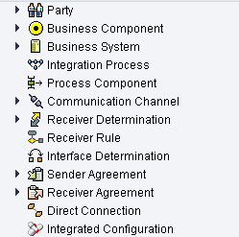
Logical Routing Objects
A Receiver Determination defines one or more receivers for a sender and an outbound interface
An Interface Determination specifies which interface is to be used for the inbound processing of a message
Notes:
You use a receiver determination to define one or more receivers for a sender and an outbound interface. The receiver can be a party or a service. You can also specify that the receiver will be determined at runtime from the message contents. You also have the option of specifying the conditions to be applied when forwarding a message to the receiver(s) in a receiver determination. A condition generally refers to the content of a message. If the specified condition is fulfilled for a particular payload element (the corresponding element has a certain value, for example), then the message is forwarded to the specified receiver(s).

Slide 9
Collaboration Agreement Objects
In the sender agreement, you define how the message is to be transformed so that it can be processed by the Integration Engine
In the receiver agreement, you define how the message is to be transformed so that it can be processed by a receiver.
Notes:
In a collaboration agreement you define which communication channel to use to process messages for particular combination of senders and receivers. In a collaboration agreement, senders and receivers can also agree on additional security settings, which refer to the content of the messages.
In outbound processing, you can use security settings to do the following:
Sign a message
Guarantee the integrity of the data
In inbound processing, you can use security settings to do the following:
Check the signature of an inbound message
Check the integrity of the data
Authorize the sender of a message

Slide 10
Integration Directory PI 7.1
Agenda
PI 7.1 Integration Directory
Overview and Concepts
Business Scenarios
Collaboration Profiles
Routing Rules
Collaboration Agreements

Slide 11
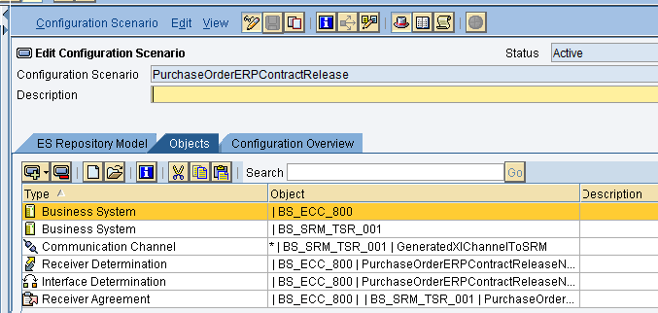
PI 7.1 Configuration: Business Scenario
Business Scenario objects (optional):
Serve as grouping for related configuration objects
Can be derived from the Integration Repository via a wizard
Can serve as the basis of the Configuration wizard (Business Scenario Configurator).
Notes:
Objects in the Integration Directory are always defined for a particular combination of key attributes. However, unlike in the Integration Repository, there are no grouping categories (such the software components and namespaces) in the Integration Directory. Using scenarios, you can group configuration objects to structure the content of the Integration Directory more clearly.
You can transport scenarios; this enables you, for example, to transport all the configuration objects belonging to one scenario from a test environment to a productive environment.
Furthermore, scenarios also provide other functions that enable you to simplify and speed up the configuration of cross-system processes considerably:
If, at design time, you defined a business scenario for the process that you want to configure, you can transfer it from the Integration Repository and use it as the template for configuration. You can visualize all the elements of the business scenario and configure them separately in the graphical editor.
The configuration assistant enables you to compile all the configuration data for a separate communication step that corresponds to a business scenario connection.

Slide 12
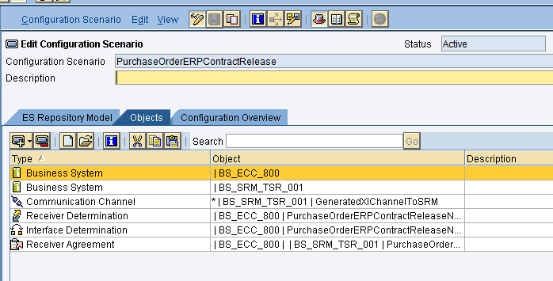
Creating Business Scenarios
Add Collaboration Profile objects (Partners, Services, and Communication Channels)
Add Logical Routing objects (Receiver Determination, Interface Determination) and Collaboration Agreement objects (Sender Agreements, Receiver Agreements) – or use the Configuration Wizard.
Notes:
Create a Business Scenario in the Integration Directory by choosing Object → New from the main menu. Give the scenario a name (the name should make sense, especially considering that the Business Scenario in the Integration Directory will probably correspond to a Business Scenario in the Integration Repository). Optionally, give the Scenario a description.
You next add Collaboration Profile objects – Parties, Services (with or without party), and Communication Channels - to the scenario.
You can then either create the Logical Routing and Collaboration Agreement objects manually, or use the configuration wizard to create these objects automatically.

Slide 13
Integration Directory PI 7.1
Agenda
PI 7.1 Integration Directory
Overview and Concepts
Business Scenarios
Collaboration Profiles
Routing Rules
Collaboration Agreements

Slide 14
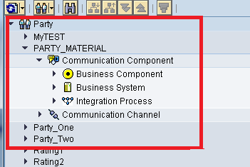
PI 7.1 Collaboration Profile: Partner (Party)
The optional object party facilitates the B2B functions of SAP Process Integration and contains the following information:
A Name and a Description
Additional identifiers (DUNS, DUNS+4, GLN)
Assigned Services
Notes:
A Party represents a larger unit, which is involved in a cross-system process, for example a company.
A Party is first of all assigned a name; it makes sense to give meaningful names to parties, as they show up by name in the navigation tree. You use the name of a party when assigning it to a scenario or otherwise using it in the Integration Directory.
The name you give a party may not match any valid external labels for the party. To use additional identifiers for the party, you can also specify alternative identifiers. This enables you to define which alternative identifiers are valid for a particular sender/receiver pair in a collaboration agreement. Alternative Identifiers have the following properties:
Agency: Specify an abbreviation for the agency. You can select from the following in the dropdown list box:
016 - for Dun & Bradstreet Corporation
009 - for EAN – International Article Numbering Association
166 - for NMFTA – National Motor Freight Traffic Association
Scheme: You can specify an identification scheme. If you select one of the standard agencies from the input help, then this field will already contain a predefined value.
Value: This value is a unique identifier for the communication party within the specified scheme (for instance, the DUNS number).
To create a party, you right-click on the Party icon in the navigation frame, or else choose Object → New from the menu, and in the ensuing dialog select Party. Give the party a meaningful name and, optionally, a description. If you created the party within a Business Scenario, it will automatically be assigned to that scenario. Alternately, you can assign a Business Scenario when you create the party, or do not assign it to a Business Scenario (an unassigned party can be added to a Business Scenario later).
You can assign then Alternative Identifiers; use the drop-down to select the Agency, and enter the identifier in the appropriate field.
To assign services to the Party: first, save your party, and it will then show in the navigation frame. Drill down through your party to the appropriate service type, right-click on that type, and choose New (for Business Service or Business Process) or Assign Business System (for Business System).

Slide 15
PI 7.1 Collaboration Profile : Communication Component without Party
Address business systems and business processes as senders or receivers of messages
Serve as grouping of interfaces for message exchange according to particular task areas
Contain the following information:
Interfaces (inbound/outbound)
Communication channels (sender/receiver)
3 Types Of communication components:
Business Component
Business System
Integration Process
Notes:
Regardless of type, services play the roles of senders and receivers of messages in XI scenarios.
Previous versions of XI addressed Business Systems as senders and receivers; Services extend the Business System concept to include other possible receivers, namely Business Processes (executable processes that extend basic functionality and message handling capabilities from both an application and integration perspective, and do it across system boundaries), and Business Services, which represent an abstract, addressable unit.

Slide 16
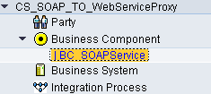
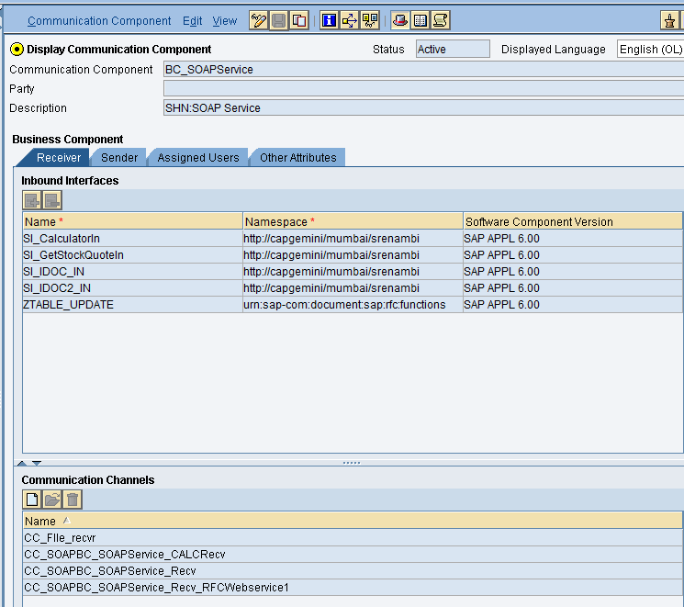
PI 7.1 Collaboration : Business Component
A Communication component represents an abstract entity for addressing the senders and receivers of messages
Communication component can be used in cross-company processes, for example, if the parties involved have only published their interfaces and not their system landscape, or it is only partly known.
With a Communication component , you can define the technical or business subunits of the companies (parties) involved and then assign the relevant interfaces
Can be used to group interfaces
Notes:
Business Services allow you to address an entity in cross-company processes when the landscape of the communication partner is unknown.
In the past, the XI used the Business System type “Third Party” in the SLD for this purpose; now you use service type “Business Service” for this purpose.
Also use service type “Business Service” when you want to group a set of interfaces.

Slide 17
PI 7.1 Service Object : Business System
Business System objects are derived directly from existing XI Business Systems in the System Landscape Directory.
As such, they contain information about Software Components assigned to the Business System, and which inbound/outbound interfaces are exposed.
Can be addressed as a sender or receiver of messages
Notes:
To address a business system from the SLD as the sender or receiver of messages in logical routing, you must define it as a service (of type Business System) in the Integration Directory.
The Software Components tab page displays all the software components of the business system. This information is defined in the SLD and cannot be modified in any way in the Integration Directory.

Slide 18
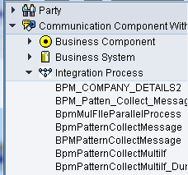
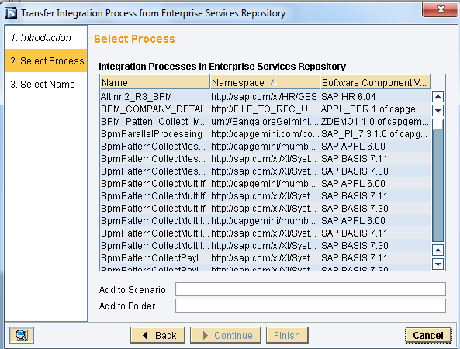
PI 7.1 Service Object : Integration Process
A Business Process can send or receive messages by using Abstract Interfaces
At configuration time, Business Processes are handled as senders and receivers or messages
Derived from the Integration Repository where the process is defined
Notes:
A business process is an executable, cross-system process. In a business process you define all the process steps that are to be executed and the parameters relevant for controlling the process. You implement cross-component Business Process Management (BPM) when you want to define, control, and monitor complex business processes that extend across enterprise and application boundaries.
A business process can send or receive messages by using its abstract interfaces. Correspondingly, at configuration time, a business process can be handled as a business system. A business process behaves like a sender or receiver of messages during routing. Therefore, when defining routing rules you can specify a business process as the sender or receiver of messages, provided you have already defined it as a service.
You create a Business Process in the Integration Directory by right-clicking on the Business Process link in the navigation frame (whether the node is under Party or Service Without Party, depending on your requirements), or by choosing Object → New from the menu, and in the ensuing dialog selecting Business Process. Either way will start the wizard that lets you import a Business Process from the Integration Repository.

Slide 19
PI 7.1 Collaboration Profile: Channel
Sender or Receiver channel
Communication Channel
Contains specific information for the message protocol, transport protocol, URL, logon data and adapter-specific configuration
For configuring specific adapters, pre-delivered communication channels, called channel templates, are available in the Integration Repository
Notes:
Communication channels specify transport mechanism for a message – for instance, the adapter type and adapter configuration parameters
You must assign a communication channel to a service. Depending on whether the service is addressed as a sender or receiver of messages, the assigned communication channel has the role of either a sender or a receiver channel, and must be configured accordingly.
Sender Communication Channel
Defines how an adapter transforms a message so that it can be processed by the Integration Engine during inbound processing. A sender channel contains the configuration data for a sender adapter.
Receiver Communication Channel
Defines how an adapter transforms a message so that it can be processed by the receiver during outbound processing. A receiver channel contains the configuration data for a receiver adapter.
The Parameters tab of the Communication Channel editing screen contain a non Adapter-specific area for specifying the adapter type, and an adapter-specific area for configuring the adapter.

Slide 20
Adapter Types
Abbreviation | Description
XI | For communicating using the proxy runtime. You can also use this adapter type to communicate with an Adapter Engine at the receiver that is based on XI 3.0
IDoc | For communicating with an SAP System by using the IDoc adapter
RFC | For communicating with an SAP System by using the RFC adapter
http | For communicating with http server by using the http adapter
JDBC | For communicating with a database system by using the JDBC adapter
JMS | For communicating with a messaging system by using the JMS adapter
Marketplace | For communicating with marketplaces (see: Marketplace Adapter)
File | For communicating with a file system by using the File/FTP adapter
SOAP | For connecting to webservices by using soap adapter
Notes:
For detailed information about the various adapter-type-specific parameters, see the documentation for the relevant adapter type.

Slide 21
Integration Directory PI 7.1
Agenda
PI 7.1 Integration Directory
Overview and Concepts
Business Scenarios
Collaboration Profiles
Routing Rules
Collaboration Agreements

Slide 22
Routing Rule: Receiver Determination
Use the condition editor to enter conditions for routing
Assign one or more receivers to a sender/outbound interface pair.
Content-based receiver determination is possible (via XPath/context objects)
Receiver should be an existing service (with or without Party).
Notes:
You use a receiver determination to define one or more receivers for a sender and an outbound interface.
You can specify receiver parties and receiver services. To specify the receiver in more detail, you have the following options:
Select the receiver from the Integration Directory
Specify a constant value for the receiver
Determine the receiver dynamically from the content of a message (at runtime)
You also have the option of specifying the conditions to be applied when forwarding a message to the receiver(s) in a receiver determination. A condition generally refers to the content of a message. If the specified condition is fulfilled for a particular payload element (the corresponding element has a certain value, for example), then the message is forwarded to the specified receiver(s).
To define a condition, use the condition editor.

Slide 23
Routing Rule: Interface Determination
Assign one or more inbound interfaces to be used for the inbound processing of a message (after the receiver determination).
Assign an Interface Mapping for each outbound-inbound interface pair
Notes:
You use an interface determination to specify for a sender and a receiver which inbound interface is to be used for the inbound processing of a message.
In an interface determination you define the following for the outbound interface of a sender:
An inbound interface
An interface mapping for the outbound and inbound interface (You are only permitted to use Interface Mappings from the Integration Repository).

Slide 24
Integration Directory PI 7.1
Agenda
PI 7.1 Integration Directory
Overview and Concepts
Business Scenarios
Collaboration Profiles
Routing Rules
Collaboration Agreements

Slide 25
PI 7.1 Collaboration Agreement
The objects Sender Agreement and Receiver Agreement
Specify a binding between an interface and a communication channel
Contain additional security settings, such as certificates.
The sender agreement is used on the Integration Server for inbound processing, the receiver agreement for outbound processing
Notes:
In a collaboration agreement you define which communication channel to use to process messages for particular combination of senders and receivers. In a collaboration agreement, senders and receivers can also agree on additional security settings, which refer to the content of the messages.
In outbound processing you can use security settings to do the following:
Sign a message
Guarantee the integrity of the data
In inbound processing you can use security settings to do the following:
Check the signature of an inbound message
Check the integrity of the data
Authorize the sender of a message
Note that in order to specify message security in a Collaboration Agreement, you must have assigned a Communication Channel of Adapter type XI using the PI 7.1 message protocol, and selected the Message Security check box in the assigned communication protocol.
In receiver agreements, you can also change elements of the message header.

Slide 26
Summary
Now you can:
Describe the Configuration Time Activities of the Process Integration
Detail the task areas and configuration objects of the Integration Directory
Create and work with Collaboration Profiles
Design Logical Routings
Work with Collaboration Agreements
Completely and correctly configure Integration Scenarios within the Integration Directory

Slide 27
SAP Process Integration
Introduction
1
2
Application Environment
3
Demonstration
4
Hands On
5
HelpMe

Slide 28
Integration Directory Demo
ID Demo

